Slide 1

Final Research Presentation
Dalton Murray

Slide 2
Introduction

Slide 3
Problem
Computer hardware, specifically Graphics Processing Units, GPUs, are becoming much more expensive but the performance doesn’t seem to make up for the price
Find the consensus of what people think about the price of computer graphics cards
Understand the feeling towards specific brands and what they are doing bad and how they can improve
Figure out why graphics cards are being priced the way they are
Verify what people are saying are backed by actions

Slide 4
Why
Optimization of games
Costs of living
Costs of technology
Right to Internet access
The United Nations believes the Internet is a fundamental right (https://www.article19.org/data/files/Internet_Statement_Adopted.pdf)
Settle a wide debate

Slide 5
Data Collection

Slide 6

How - Implementation
Determine an amount of data wanted
Reddit
Find posts that relate to the topic and are from varying Reddit communities
Universal Reddit Scraper (URS)
Reddit API
Reddit Developer Applications
Format & Organize output data
Create R file and perform analysis
Manual review

Slide 7
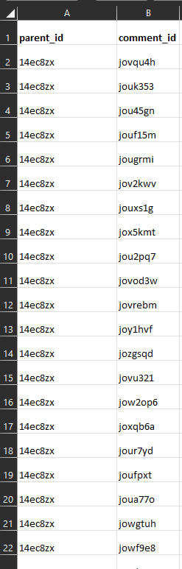
Dataset
Create a file with only the connections between the comment id and the parent id
2,364 rows

Slide 8
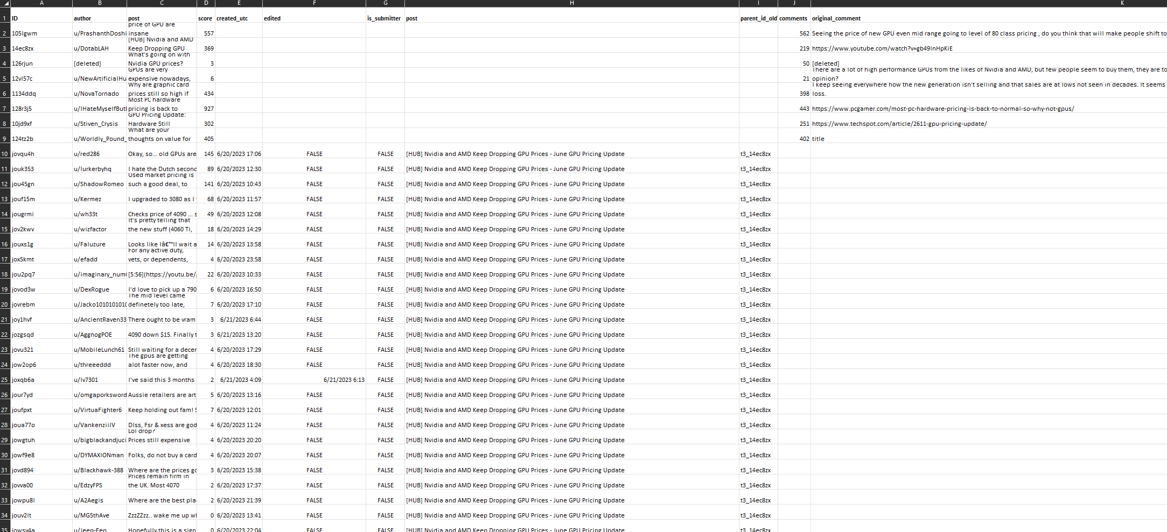
Dataset - 2

Slide 9
Visualizations

Slide 10
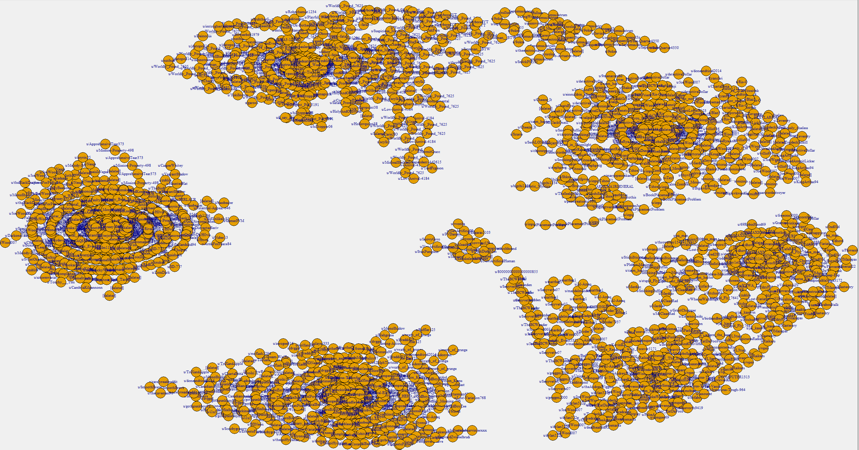

Slide 11
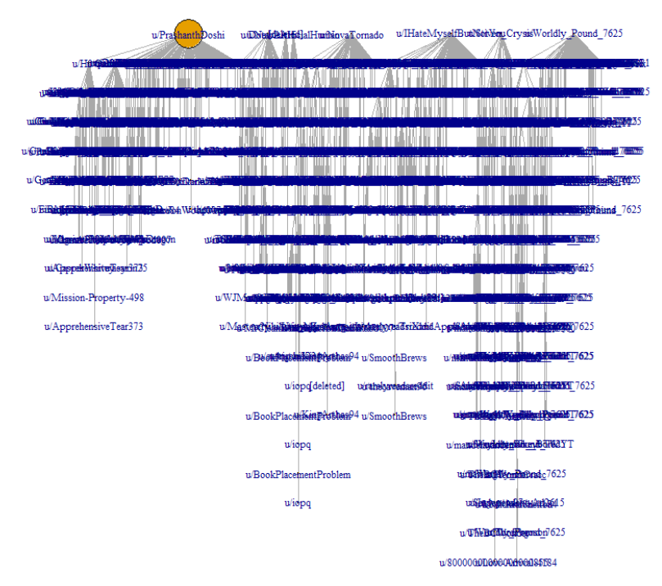

Slide 12
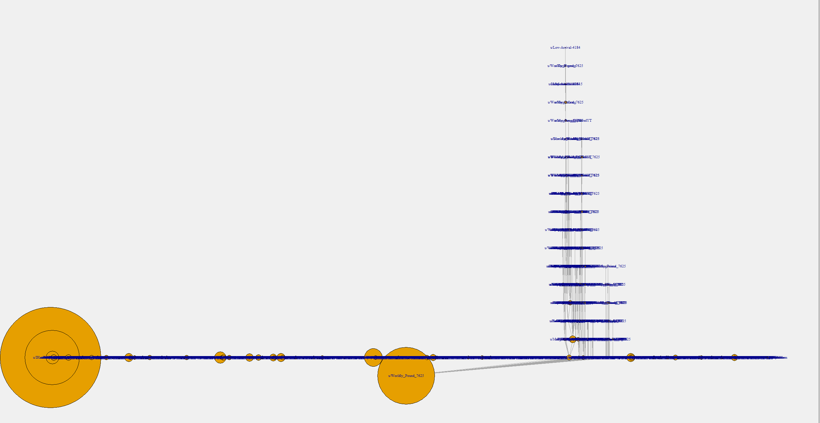

Slide 13
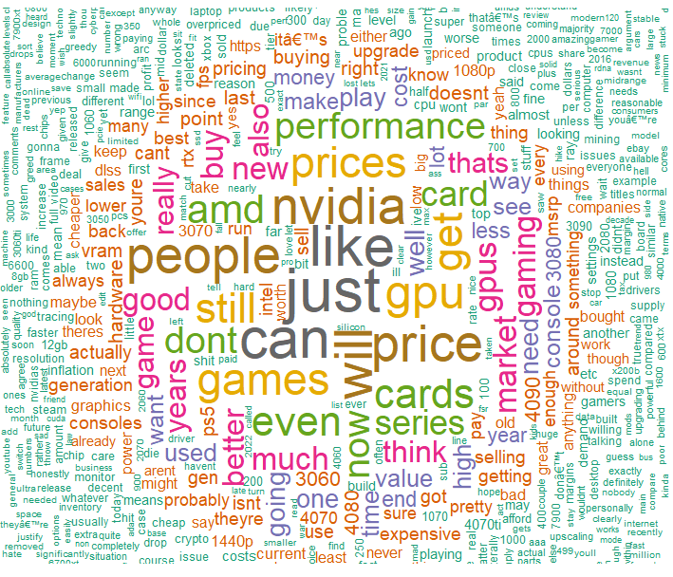
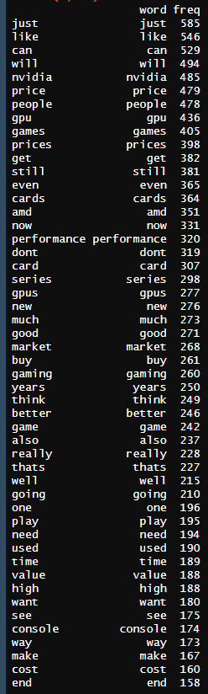

Slide 14
Results

Slide 15
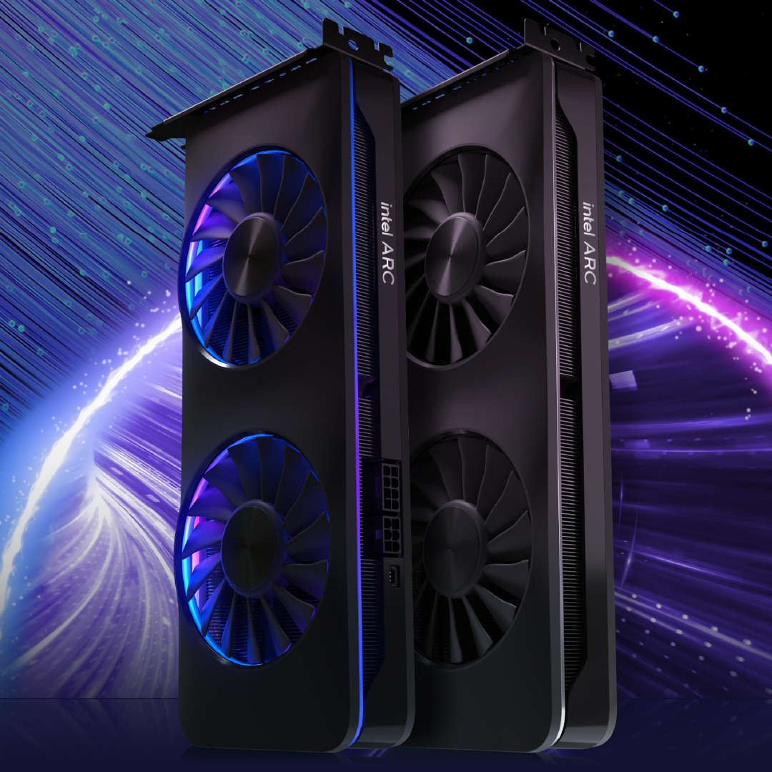
Results - Intel
Only recently started making graphics cards
Pricing is a great deal
Great budget GPU
Performance equal to most mid to high-end cards
Lack of driver support/low quality/bugs
Working on better drivers
Increased performance
(https://game.intel.com/story/intel-arc-graphics-a7series-perf-per-dollar/)

Slide 16
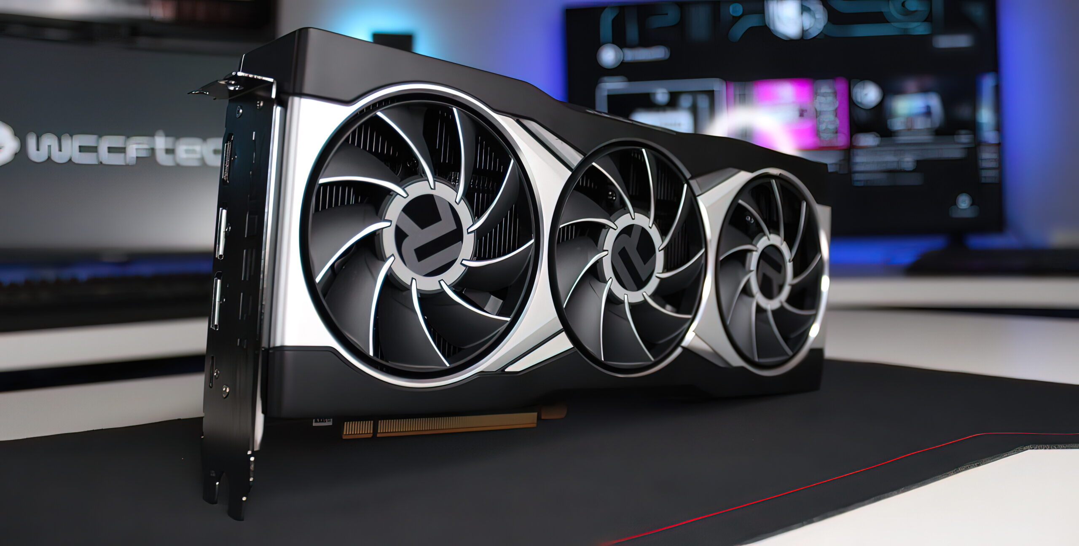
Results - AMD
Most people agree best budget GPU
Performance matches price well
Not underpaying or overpaying
Quite far behind top performance Nvidia graphics cards
(https://wccftech.com/roundup/amd-radeon-rx-7800-xt/)

Slide 17
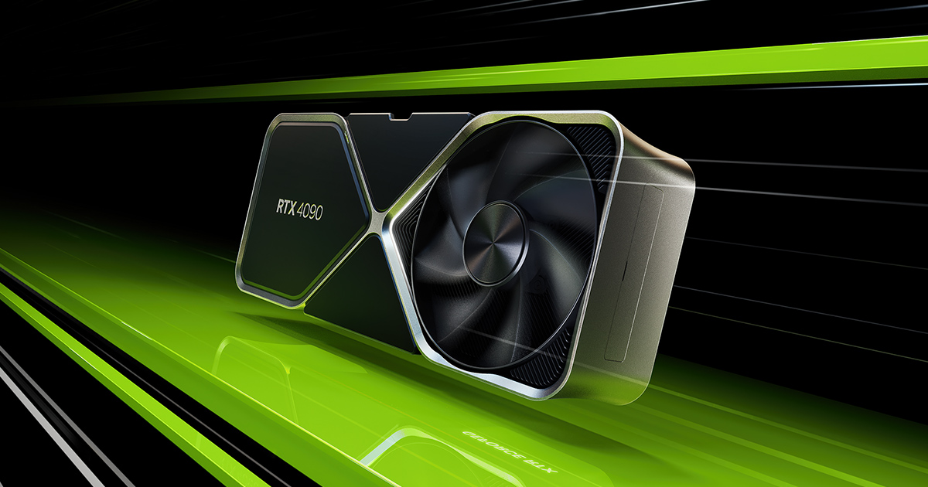
Results - Nvidia
Number one seller
Most despised brand
Most number of negative feelings and talk
Highest performance graphics cards
Graphics cards too expensive/overpriced
Lack of VRAM
(https://www.nvidia.com/en-us/geforce/graphics-cards/40-series/rtx-4090/)

Slide 18
Proposal/Solution
Intel
Keep working on firmware/drivers
Increase performance to match Nvidia high end
Include more VRAM
AMD
Create a high-end card
Most cards are only low-mid range
Balance high-end card with price
Work on performance
Nvidia
Lower prices but not performance
Increase VRAM

Slide 19
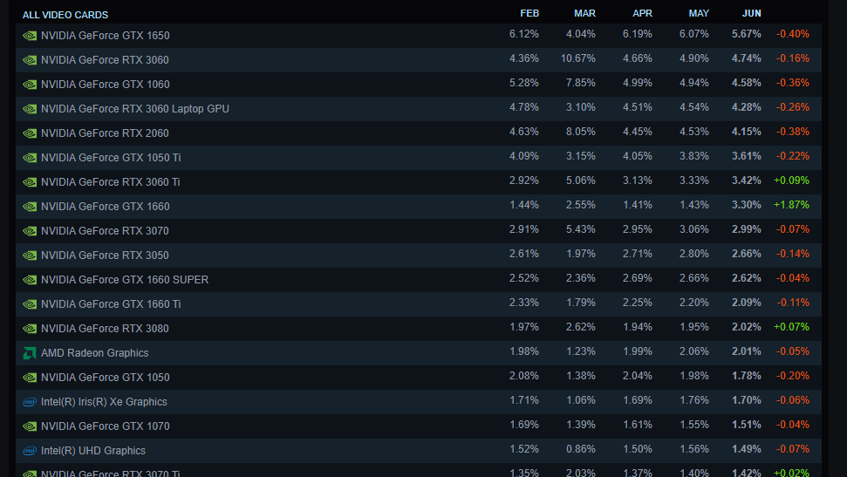
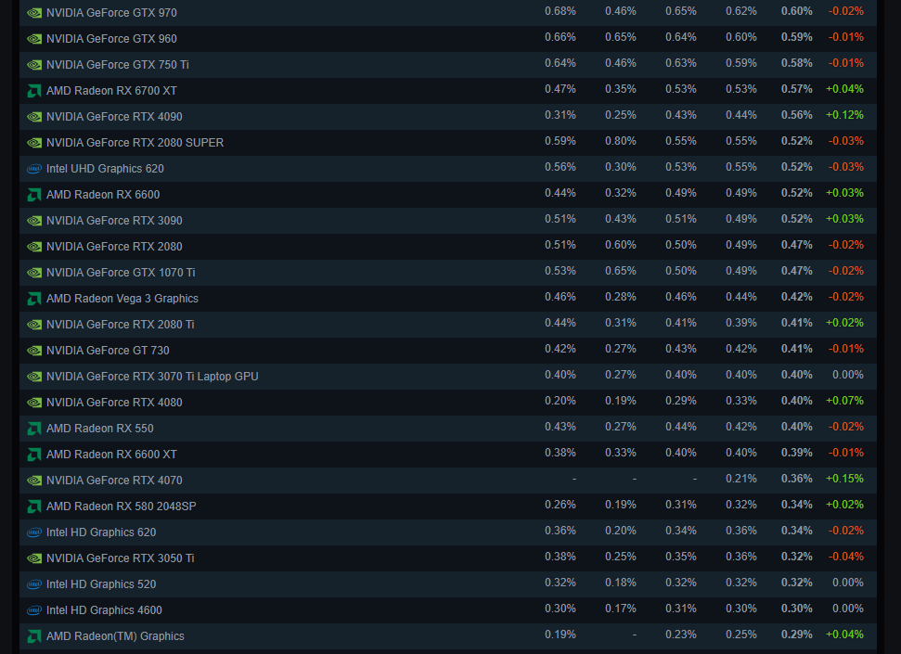
Verification
Important to verify that what people are saying are backed by their actions

Slide 20
Verification - 2
We can see that Nvidia is clearly the most popular, which is backed by Reddit data
We can see that a low-end Nvidia card is also the most used
The highest end Nvidia card only has 0.56% of people using it as of June 2023
The data from the Steam hardware survey verified that our data is correct by showing low-end cards which are the most budget friendly have the most people using them as most people cannot afford the high-end cards
This also shows that AMD and Intel need to boost their performance, as they barely can compare to NVidia's overall percentage of users

